Slide 1
Noun-Level Semantic Similarity for Sentence Pair Evaluation Using Token Embeddings
UMAP and Heatmap Visualizations

Slide 2
Goal
Compare the Token-Level Nouns (NOUN and PROPN) from each sentence pair
Compares each noun in the ground-truth sentence to all nouns in the corresponding generated sentence
Compute a similarity for the pair of sentences based on these Token-to-Token similarities.
Plot using Uniform Manifold Approximation and Projection (UMAP)
Use KDTree (scipy.spatial.KDTree) – for overlapping points (finding points within a specified distance of other points).

Slide 3
What is UMAP?
Dimensionality Reduction Technique
Takes High-Dimensional Vectors
Embeddings of the PoS Noun tokens from SentenceTransformer
Projects Vectors down to 2-Dimensions so they can be visualized in a scatter plot

Slide 4
UMAP Steps
For a sentence pair (ground-truth vs. generated):
Extract nouns (or noun phrases) from both sentences.
Embed each noun using a SentenceTransformer:
Model: SciBERT (allenai/scibert_scivocab_uncased)
URL: https://huggingface.co/allenai/scibert_scivocab_uncased
Details: Pre-trained BERT model trained on massive corpus of scientific papers from semanticscholar.org
Project Embeddings to 2D Using UMAP
Combine the ground-truth and generated embeddings into a single matrix.
Apply UMAP for dimensionality reduction to output 2D coordinates for visualization.
Parameters:
n_neighbors (6) – very local structure (more sensitive to noise)
Controls local vs. global structure (default: 15)
min_dist (0.3) – moderate spacing
Controls compactness of clusters (default: 0.1)
random_state (1): For reproducibility
Visualize Using Plotly Subplots

Slide 5
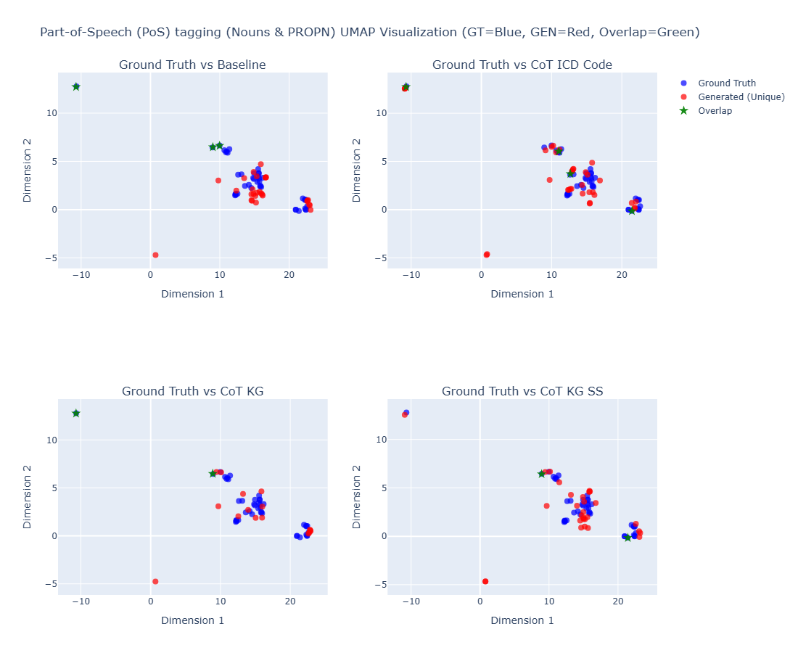
Sample #1
Clinical Case B:
ICD Code: K08109
Text Reference: edentulism
Result Samples:
BASELINE_R003_GENERATED_TEXT
COTSS_R005_GENERATED_TEXT
COTKG_R009_GENERATED_TEXT
COTSSKG_R006_GENERATED_TEXT
The chosen parameters random_state (1), n_neighbors (6) and min_dist (0.3) effectively highlight lexical and conceptual precision in generated outputs.

Slide 6
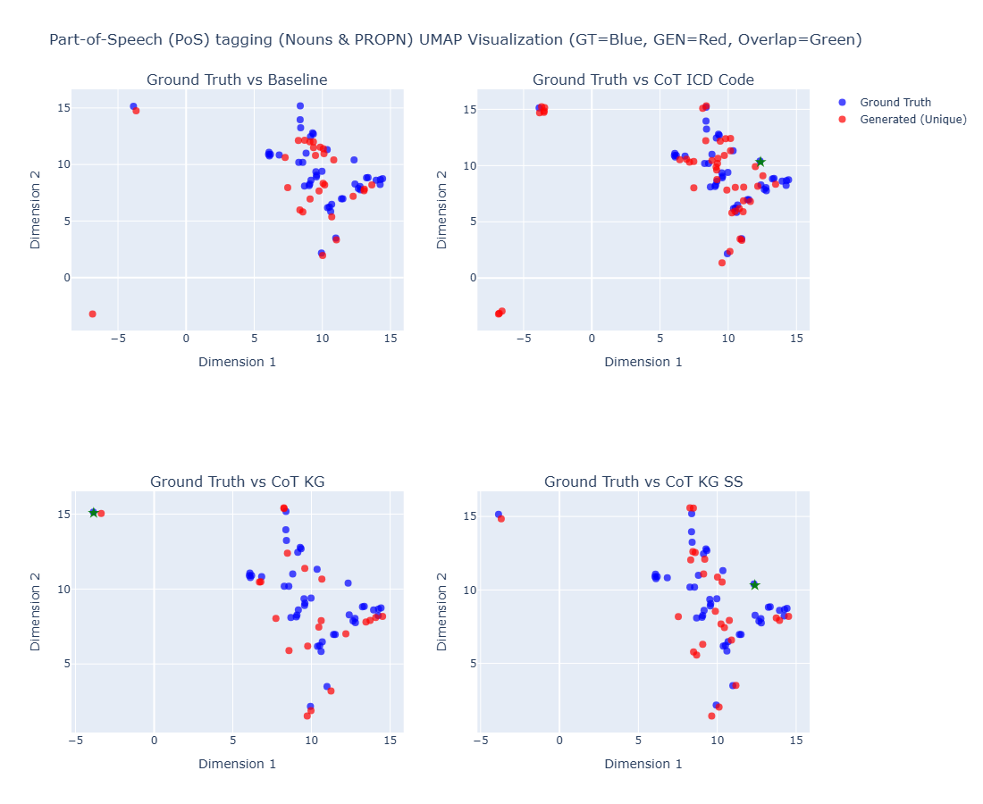
Sample #2
Clinical Case B:
ICD Code: K08109
Text Reference: edentulism
Result Samples:
BASELINE_R041_GENERATED_TEXT
COTSS_R044_GENERATED_TEXT
COTKG_R028_GENERATED_TEXT
COTSSKG_R033_GENERATED_TEXT
The chosen parameters random_state (1), n_neighbors (6) and min_dist (0.3) effectively highlight lexical and conceptual precision in generated outputs.

Slide 7
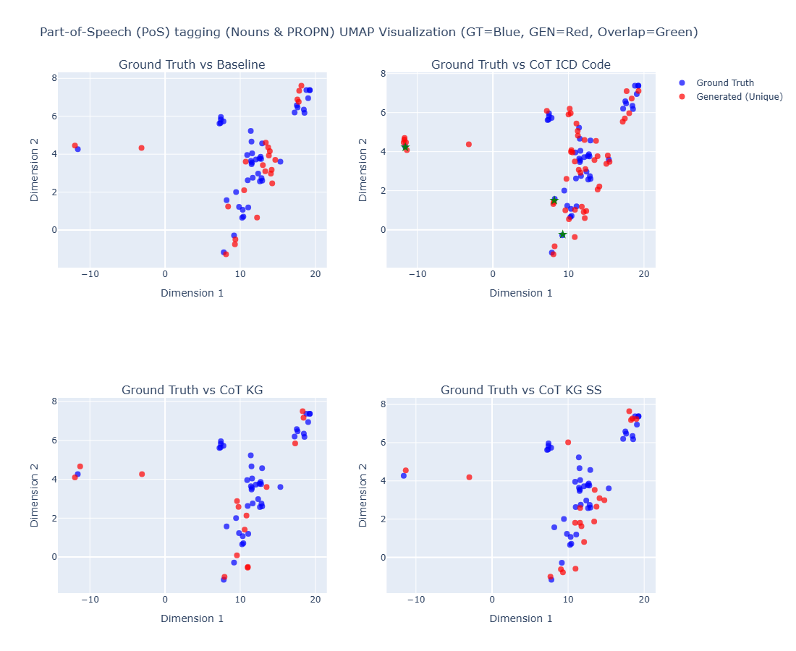
Sample #3
Clinical Case B:
ICD Code: K08109
Text Reference: edentulism
Result Samples:
BASELINE_R068_GENERATED_TEXT
COTSS_R057_GENERATED_TEXT
COTKG_R042_GENERATED_TEXT
COTSSKG_R051_GENERATED_TEXT
The chosen parameters random_state (1), n_neighbors (6) and min_dist (0.3) effectively highlight lexical and conceptual precision in generated outputs.

Slide 8
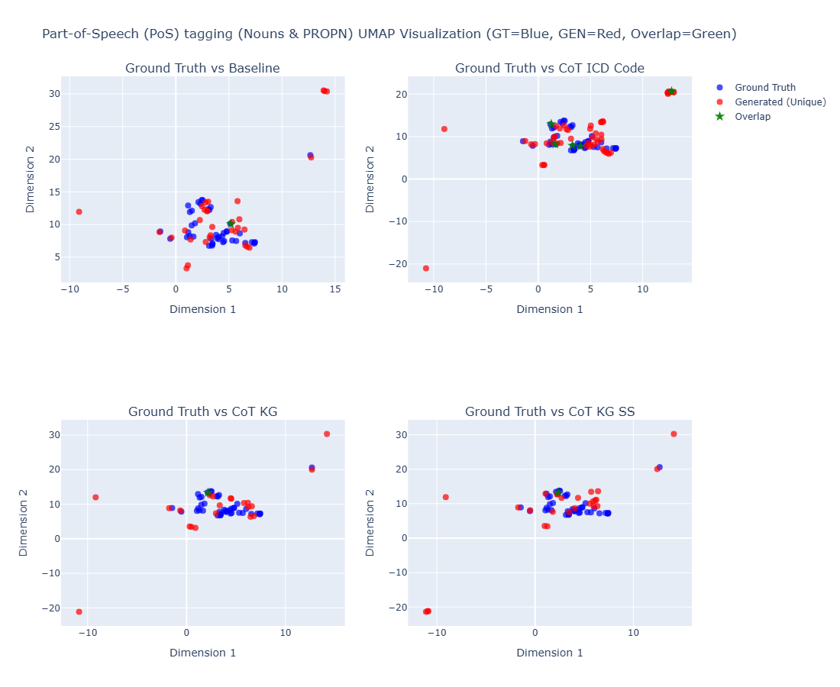
Sample #4
Clinical Case B:
ICD Code: K08109
Text Reference: edentulism
Result Samples:
BASELINE_R088_GENERATED_TEXT
COTSS_R074_GENERATED_TEXT
COTKG_R069_GENERATED_TEXT
COTSSKG_R065_GENERATED_TEXT
The chosen parameters random_state (1), n_neighbors (6) and min_dist (0.3) effectively highlight lexical and conceptual precision in generated outputs.

Slide 9
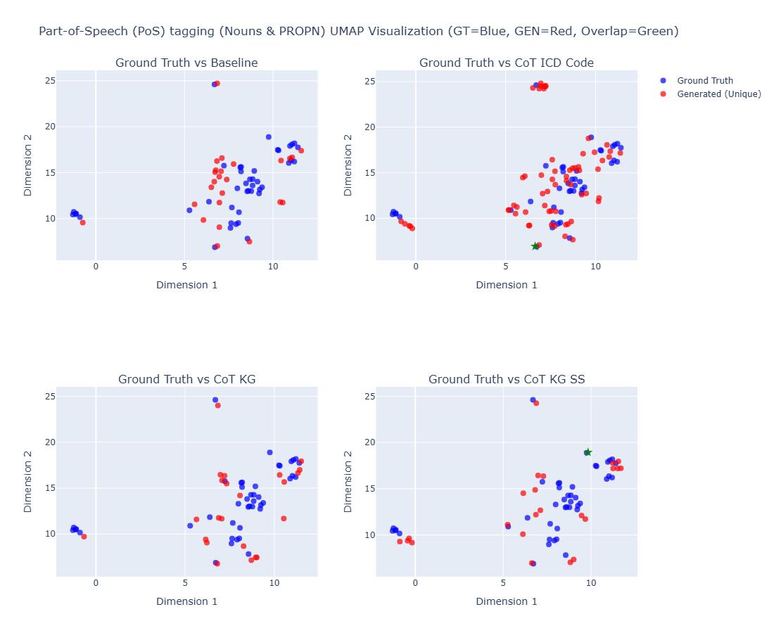
Sample #5
Clinical Case B:
ICD Code: K08109
Text Reference: edentulism
Result Samples:
BASELINE_R096_GENERATED_TEXT
COTSS_R095_GENERATED_TEXT
COTKG_R084_GENERATED_TEXT
COTSSKG_R078_GENERATED_TEXT
The chosen parameters random_state (1), n_neighbors (6) and min_dist (0.3) effectively highlight lexical and conceptual precision in generated outputs.

